Slide 1
Session Tracking with JSP

Slide 2
Topics
Session Tracking Demo
Session - Coding Steps
Full JSP Session Example

Slide 3
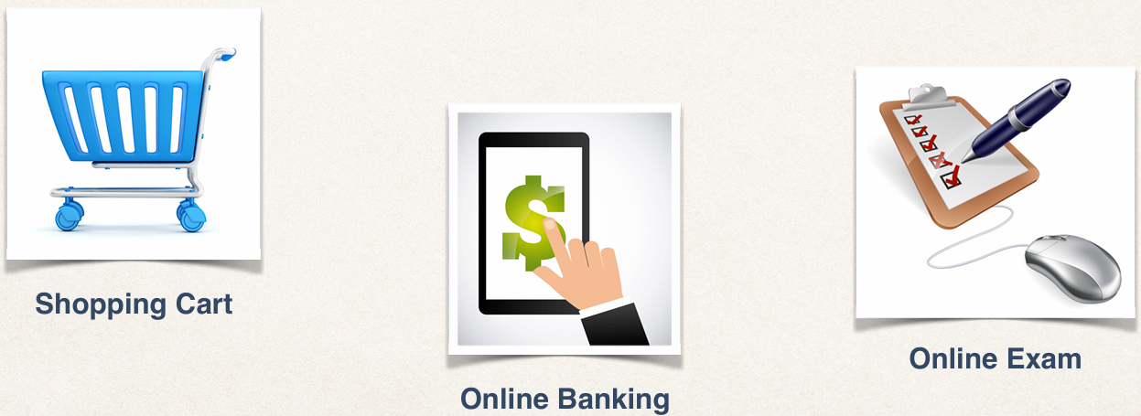
JSP session object
JSP session is created once for user’s browser session. Unique for this user
Commonly used when you need to keep track of the user’s actions

Slide 4
Session Demo Example
JSP page to manage a TO DO list
List of items will be stored in the user’s session object
Each user will have their own TO DO list

Slide 5
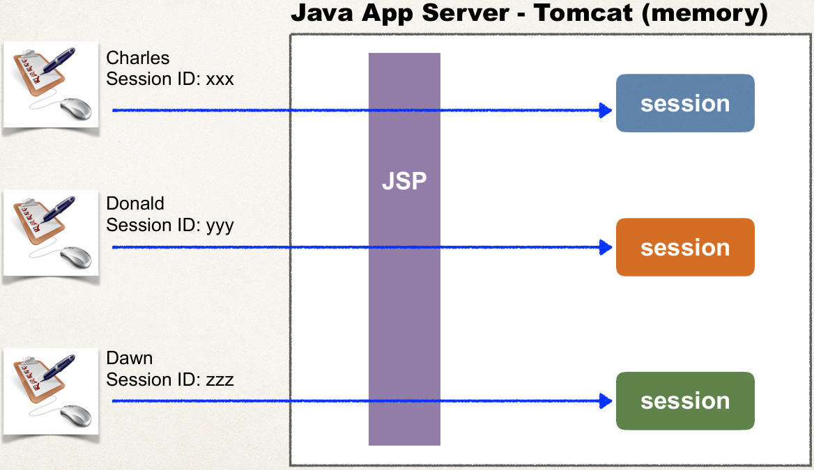
Big Picture

Slide 6
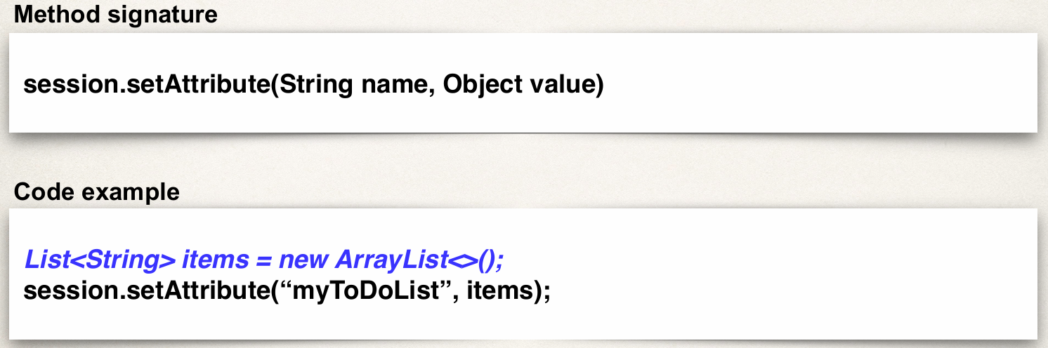
Add data to session object

Slide 7
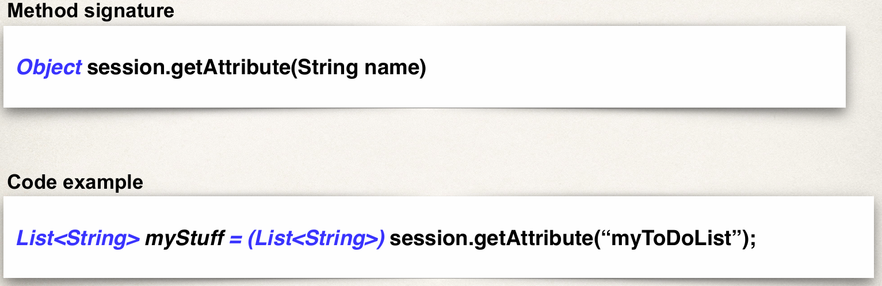
Retrieve data from session object

Slide 8
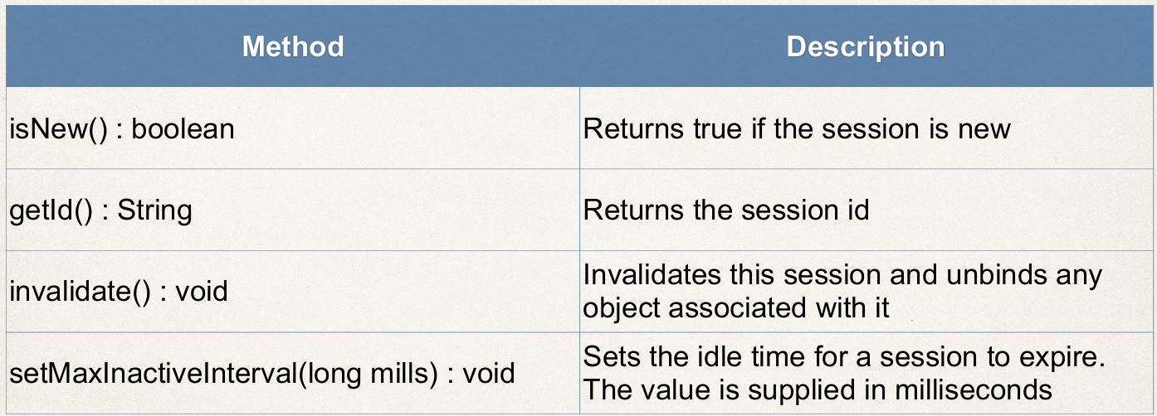
JSP Session - Other useful methods

Slide 9
Cookies

Slide 10
Topics
What are Cookies?
Cookies API

Slide 11
What is the Purpose of Cookies?
Personalize a web site for a user
Keep track of user preferences
Favorite programming language: Java
Favorite departure airport: Philadelphia (PHL)
Etc…

Slide 12
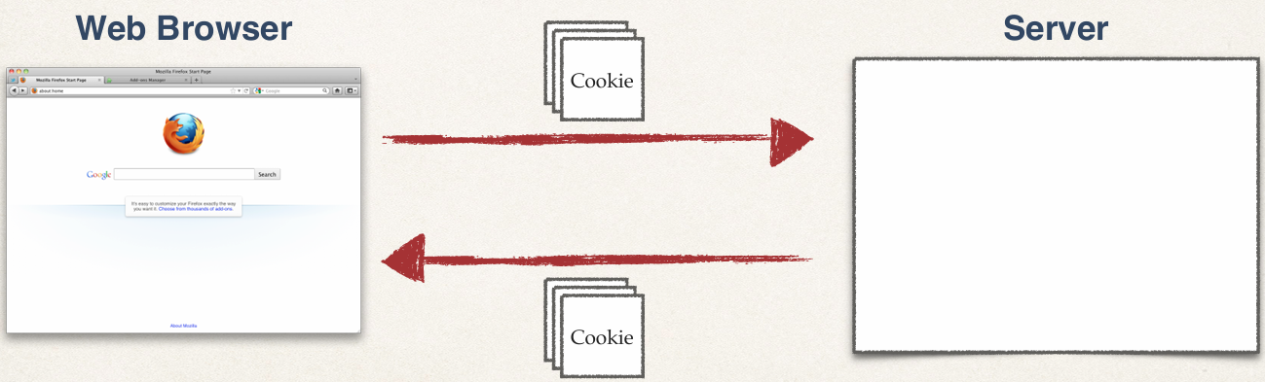
What is a Cookie?
Text data exchanged between web browser and server

Slide 13
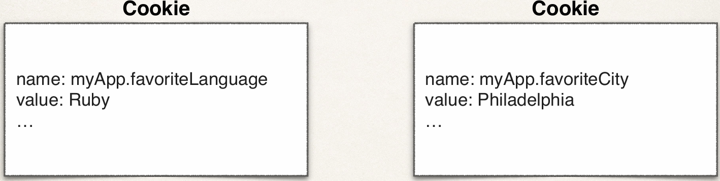
Cookies - Contents
Name / value pair

Slide 14
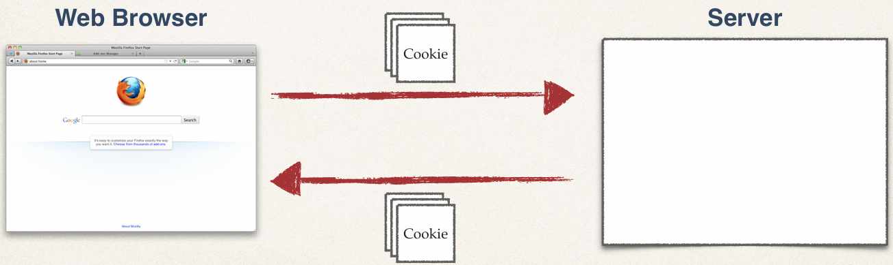
How Are Cookies Passed?
Browser will only send cookies that match the server’s domain name

Slide 15
Cookie API - Package
Cookie class defined in package: javax.servlet.http
Package imported for free in all JSP pages

Slide 16
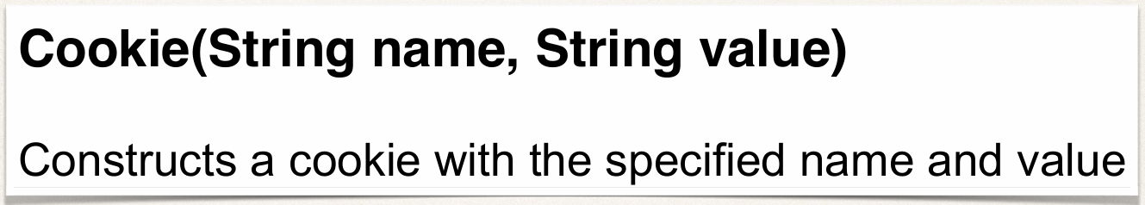
Cookie API - Constructor

Slide 17
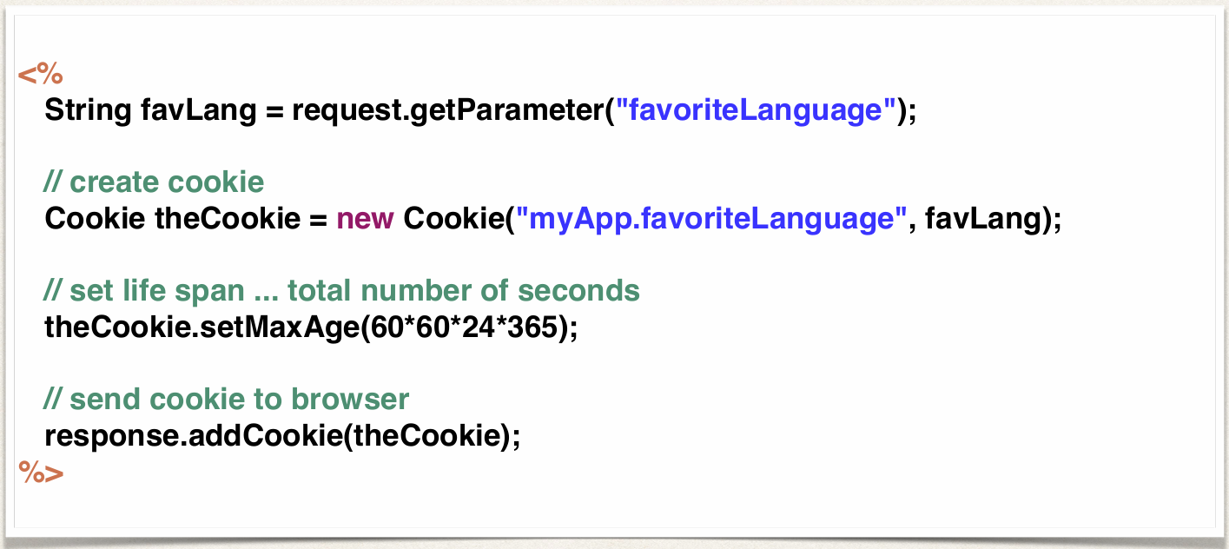
Cookies API - Sending Cookies to Browser

Slide 18
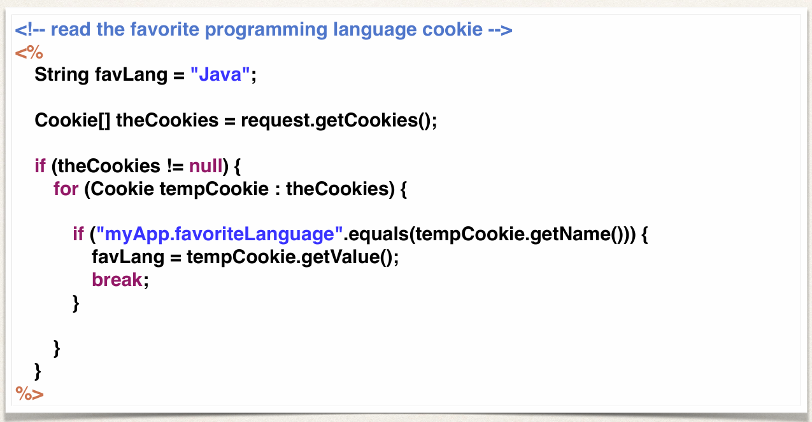
Cookies API - Reading Cookies from the Browser

Slide 19
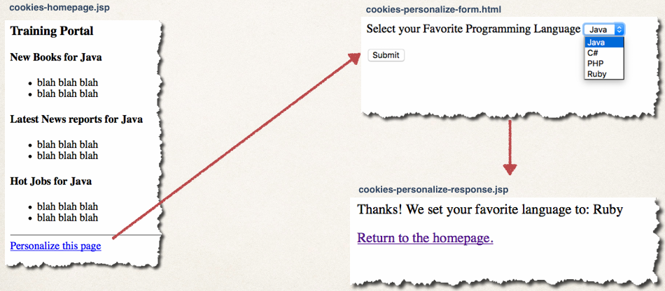
Pulling It All Together

